Slide 1
5G & Edge Computing in Web Applications – WebSockets
R.DANUSPRIYAA
192411182
Notes:
5G and Edge Computing in Web Applications, with a special focus on WebSockets. These technologies are important for applications that require fast and real-time communication, such as online gaming, chat applications, live tracking and IoT

Slide 2
Introduction
Why Real-Time Web Applications Are Needed ?
Modern applications require instant data updates
Users expect fast and responsive applications
Traditional request-response communication can cause delays
Real-time applications continuously exchange information
5G + Edge Computing + WebSockets help reduce latency
Examples:
Online gaming
Live chat
Video conferencing
Food delivery tracking
Stock market applications
IoT monitoring
Notes:
Today, users expect applications to update information immediately. For example, when we track a food delivery, we expect the driver's location to update continuously. Real-time communication is therefore important, and 5G, Edge Computing and WebSockets can help provide this experience.

Slide 3
What is 5G?
5G – Fifth Generation Mobile Network
Key Features:
🚀 High Speed
⚡ Low Latency
📡 High Network Capacity
🔗 Supports Massive Connectivity
🔄 More Reliable Communication
Benefits for Web Applications:
Faster data transmission
Quick response time
Better support for real-time applications
Improved mobile user experience
What is Latency?
Latency = Time taken for data to travel from sender to receiver.
Notes:
5G stands for fifth-generation mobile network technology. One of its important features is low latency. Low latency means less delay between sending and receiving data. This is useful for applications such as online gaming, video communication and real-time tracking.

Slide 4
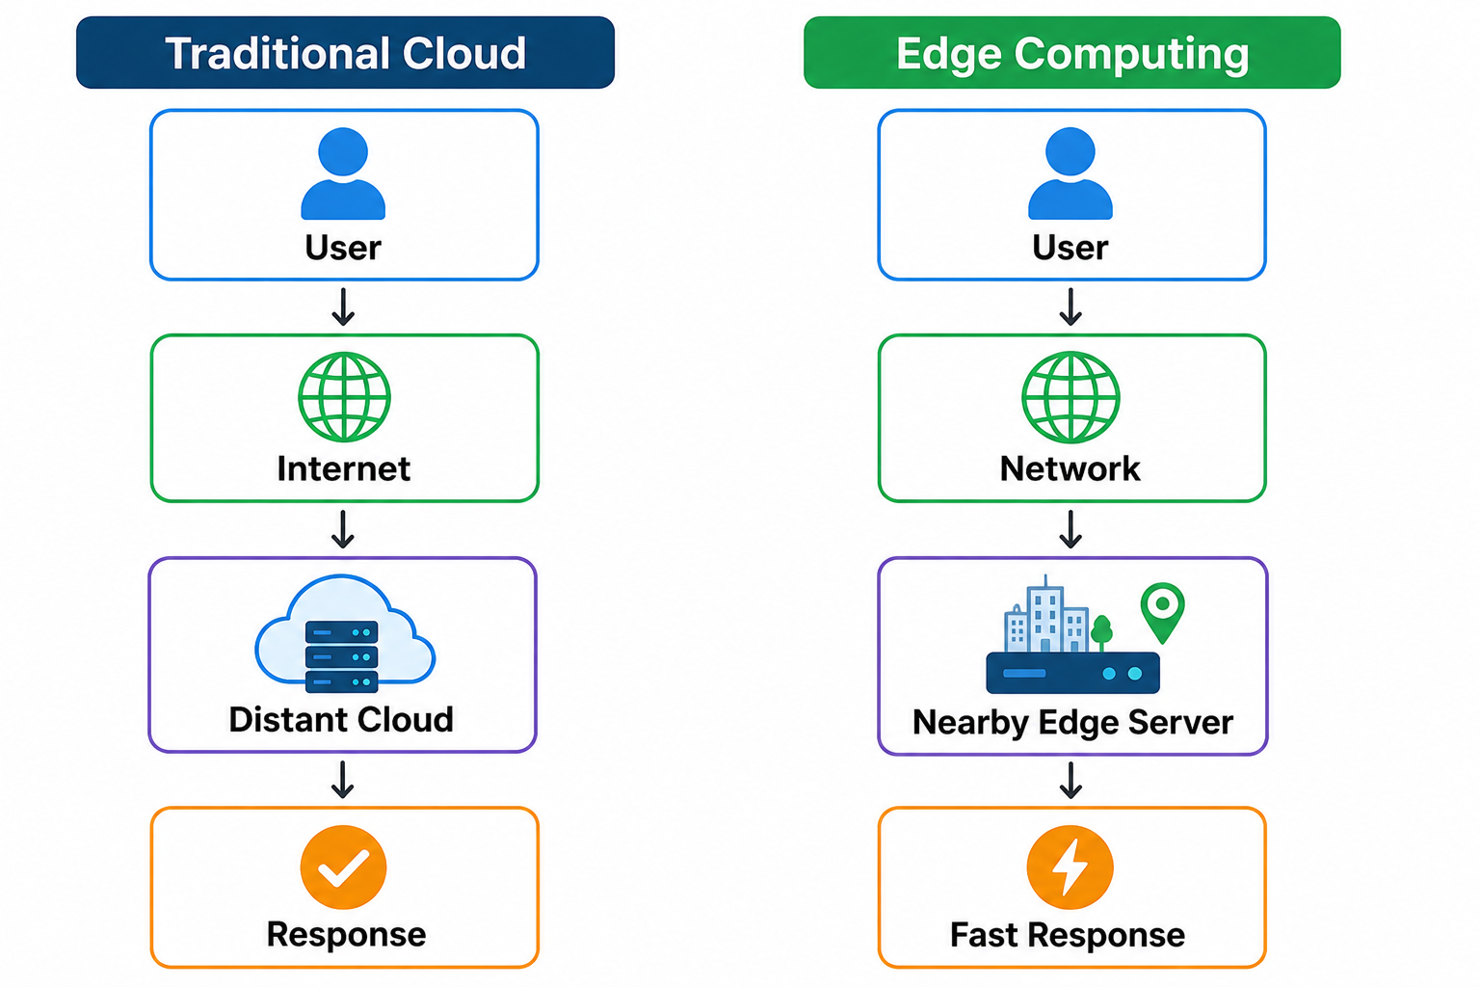
What is Edge Computing?
Edge Computing
Processing data closer to the user or device instead of sending everything to a distant cloud server.
Benefits:
Reduced latency
Faster response
Less network traffic
Better real-time performance
Local processing of data
Notes:
Normally, data may travel to a cloud server that is far away. Edge computing places computing resources closer to the user. Because the distance is reduced, some data can be processed faster

Slide 5
What are WebSockets?
WebSockets
A communication protocol that enables persistent, two-way communication between a client and server.
Key Characteristics:
🔄 Persistent connection
↔️ Two-way communication
⚡ Real-time data exchange
📡 Server can push data to clients
🔁 No repeated request required for every update
Examples:
Chat applications
Online gaming
Live notifications
Stock price updates
Live tracking
Simple Example:
Without WebSocket:
Client → Request
Server → Response
Client → Request
Server → Response
With WebSocket:
Client ↔ WebSocket Server
Continuous Connection
Notes:
WebSocket allows the client and server to maintain an open connection. Once the connection is established, both sides can send data whenever necessary. This makes WebSockets very useful for real-time applications

Slide 6
HTTP vs WebSocket
Feature | HTTP | WebSocket
Communication | Request–Response | Two-way
Connection | Request based | Persistent
Real-time updates | Less suitable | Highly suitable
Server can initiate updates | Usually requires another mechanism | Yes
Best use | Websites, APIs | Chat, gaming, live tracking
Example:
HTTP:
“Do I have a new message?”
WebSocket:
Server automatically sends: “You have a new message!”
Notes:
HTTP is mainly based on the request-response model. The client sends a request and waits for a response. WebSocket maintains a persistent connection, allowing the server to send updates immediately. Therefore, WebSocket is better for applications requiring continuous real-time communication.

Slide 7
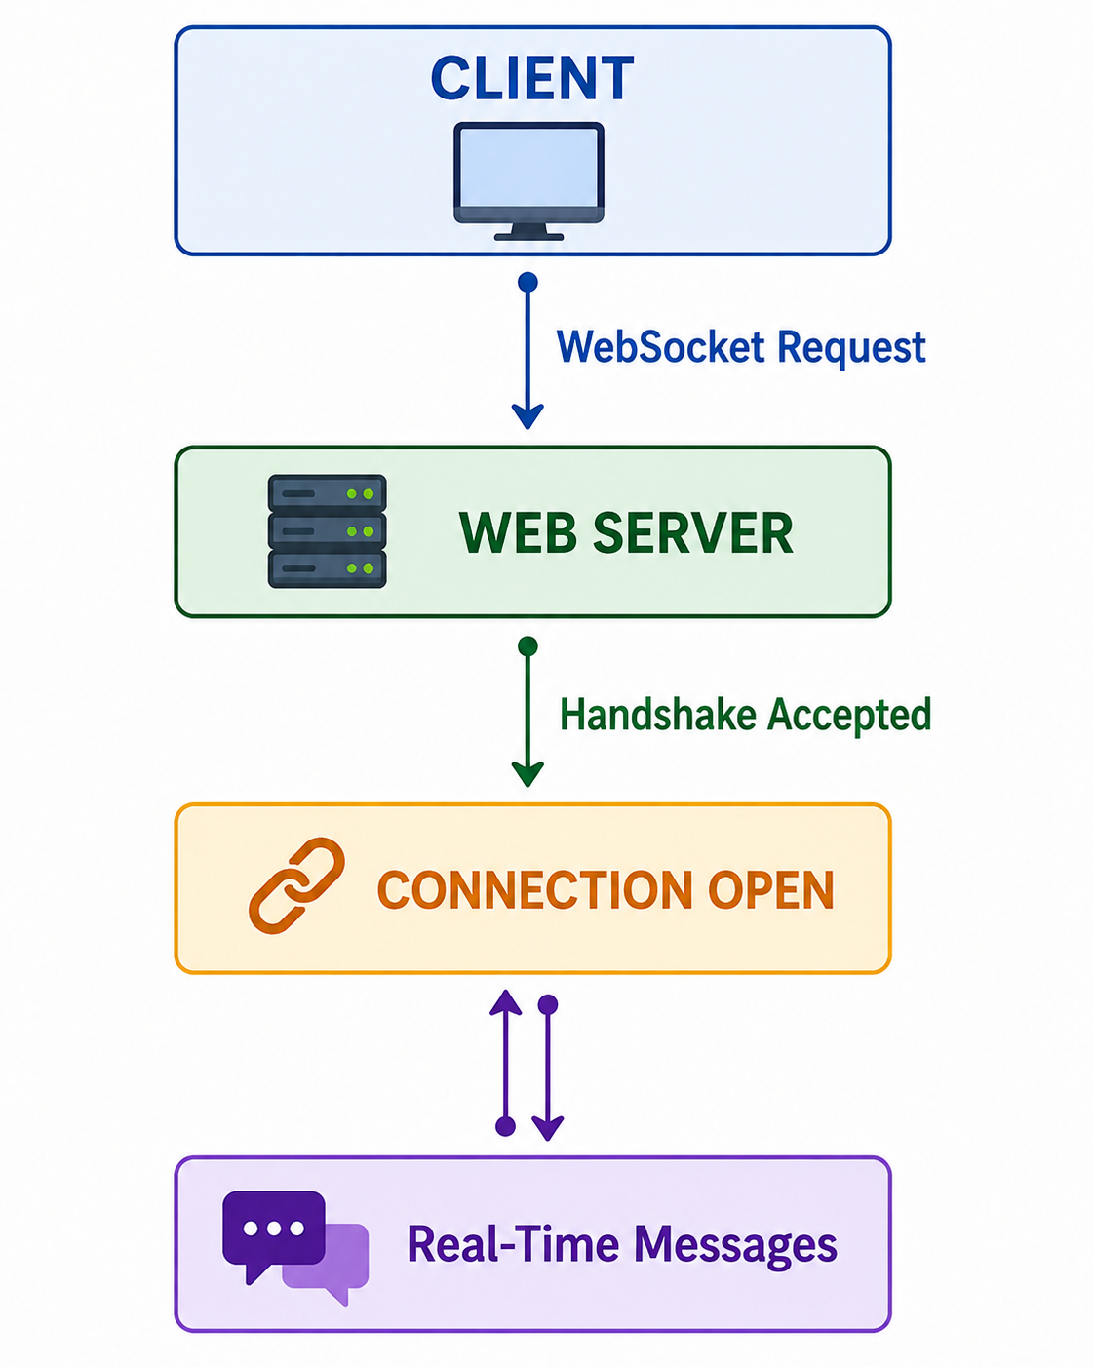
How WebSockets Work
WebSocket Communication Process
Step 1 – Connection Request
Client requests a WebSocket connection.
Step 2 – Handshake
Server accepts the WebSocket connection.
Step 3 – Connection Established
A persistent connection is created.
Step 4 – Data Exchange
Client and server can continuously exchange messages.
Notes:
The process begins with a WebSocket handshake. Once the server accepts it, the connection remains open. The client and server can then exchange messages continuously without creating a new connection for every message.

Slide 8
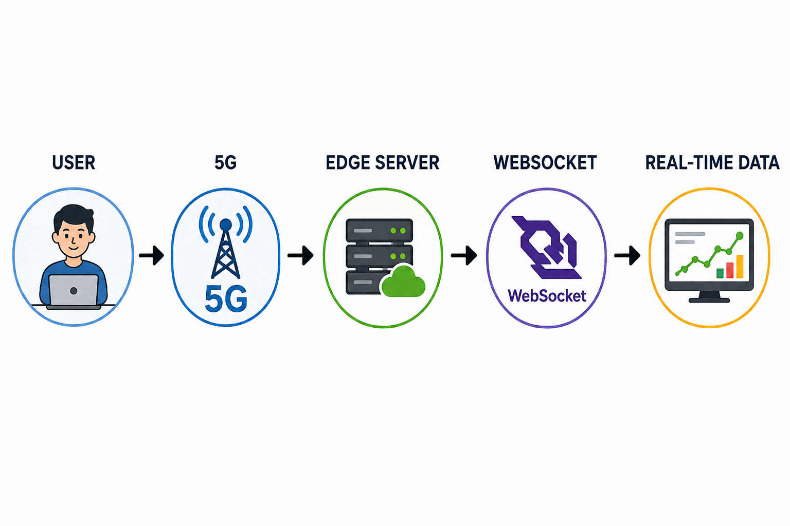
5G + Edge Computing + WebSockets
How They Work Together
Technology | Main Role
5G | Fast and low-latency connectivity
Edge Computing | Processing closer to users
WebSockets | Continuous two-way communication
Notes:
These three technologies perform different functions. 5G provides fast connectivity. Edge computing brings processing closer to the user. WebSockets provide continuous communication between the application and server. Together, they can create highly responsive web applications.

Slide 9
Real-World Applications
Applications of 5G + Edge + WebSockets
🎮 Online Gaming
Player movements
Game events
Live scores
💬 Chat Applications
Instant messaging
Online status
Notifications
📍 Live Tracking
Food delivery
Cab tracking
Vehicle monitoring
🌐 IoT
Sensor monitoring
Smart devices
Industrial systems
📈 Financial Applications
Live stock prices
Market updates
Trading information
🎥 Video & Collaboration
Online classes
Video conferencing
Collaborative applications

Slide 10
Advantages & Challenges
Advantages & Challenges
Advantages
⚡ Low latency
🔄 Real-time communication
🚀 Faster response
📱 Better user experience
🌐 Supports many connected devices
📊 Efficient live data updates
Challenges
🔐 Security requirements
📈 Scaling many WebSocket connections
💰 Edge infrastructure cost
📡 5G coverage limitations
🔄 Connection failure and reconnection
🖥️ Server resource management
Notes:
Although these technologies provide many advantages, they also have challenges. WebSocket connections must be secured, and servers need to manage potentially large numbers of persistent connections. Edge infrastructure can also increase deployment costs.

Slide 11
Conclusion
5G → Fast and low-latency connectivity
Edge Computing → Processing closer to users
WebSockets → Persistent real-time communication
Together → Responsive and real-time web application
5G, Edge Computing and WebSockets complement each other. 5G provides fast connectivity, Edge Computing reduces the distance to processing, and WebSockets enable continuous two-way communication

Slide 12
THANK YOU!

